Slide 1
Mahindra First Choice Services
Presented by:
Abhishek Kumar

Slide 2
Datasets
Customers
Invoice
Inventory
Row – 555338
Column – 9
4/9 Columns having 90% + null values
Row – 492314
Column – 58
7/58 Columns having 90% + null values
30/58 Columns having 40% + null values
25/58 Columns having single/null values
Row – 5619484
Column – 9
1/9 Columns having 67% null values
8/9 Columns having >1% null values
Dataset is provided in excel and csv format

Slide 3
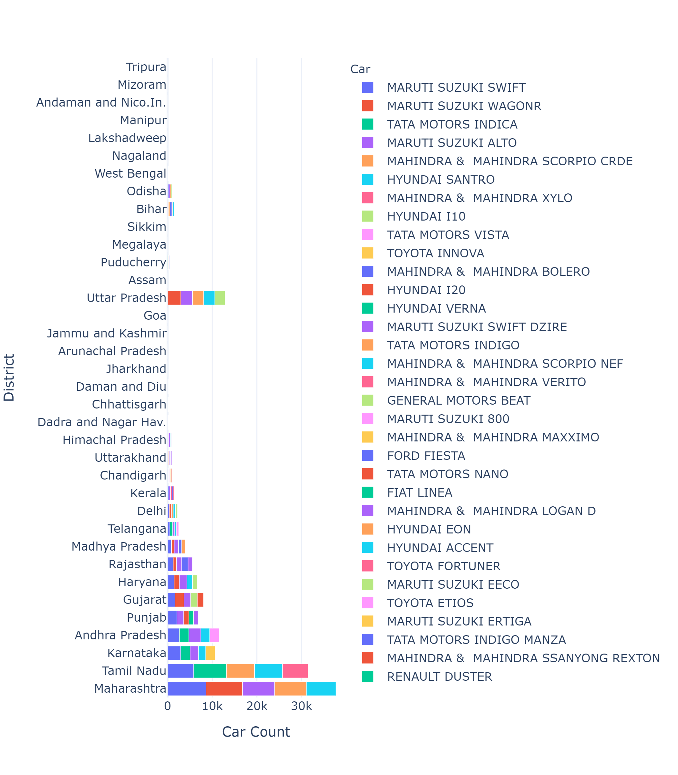
Problem Statement 1 : Identifying the ownership pattern
This chart depicts car count by each state
90% of the car belongs to first 10 States
Chart suggest that economical cars are most popular
Avigo, Z4, Pushpak, Estilo, Trailblazer are least owned cars at count of 1

Slide 4
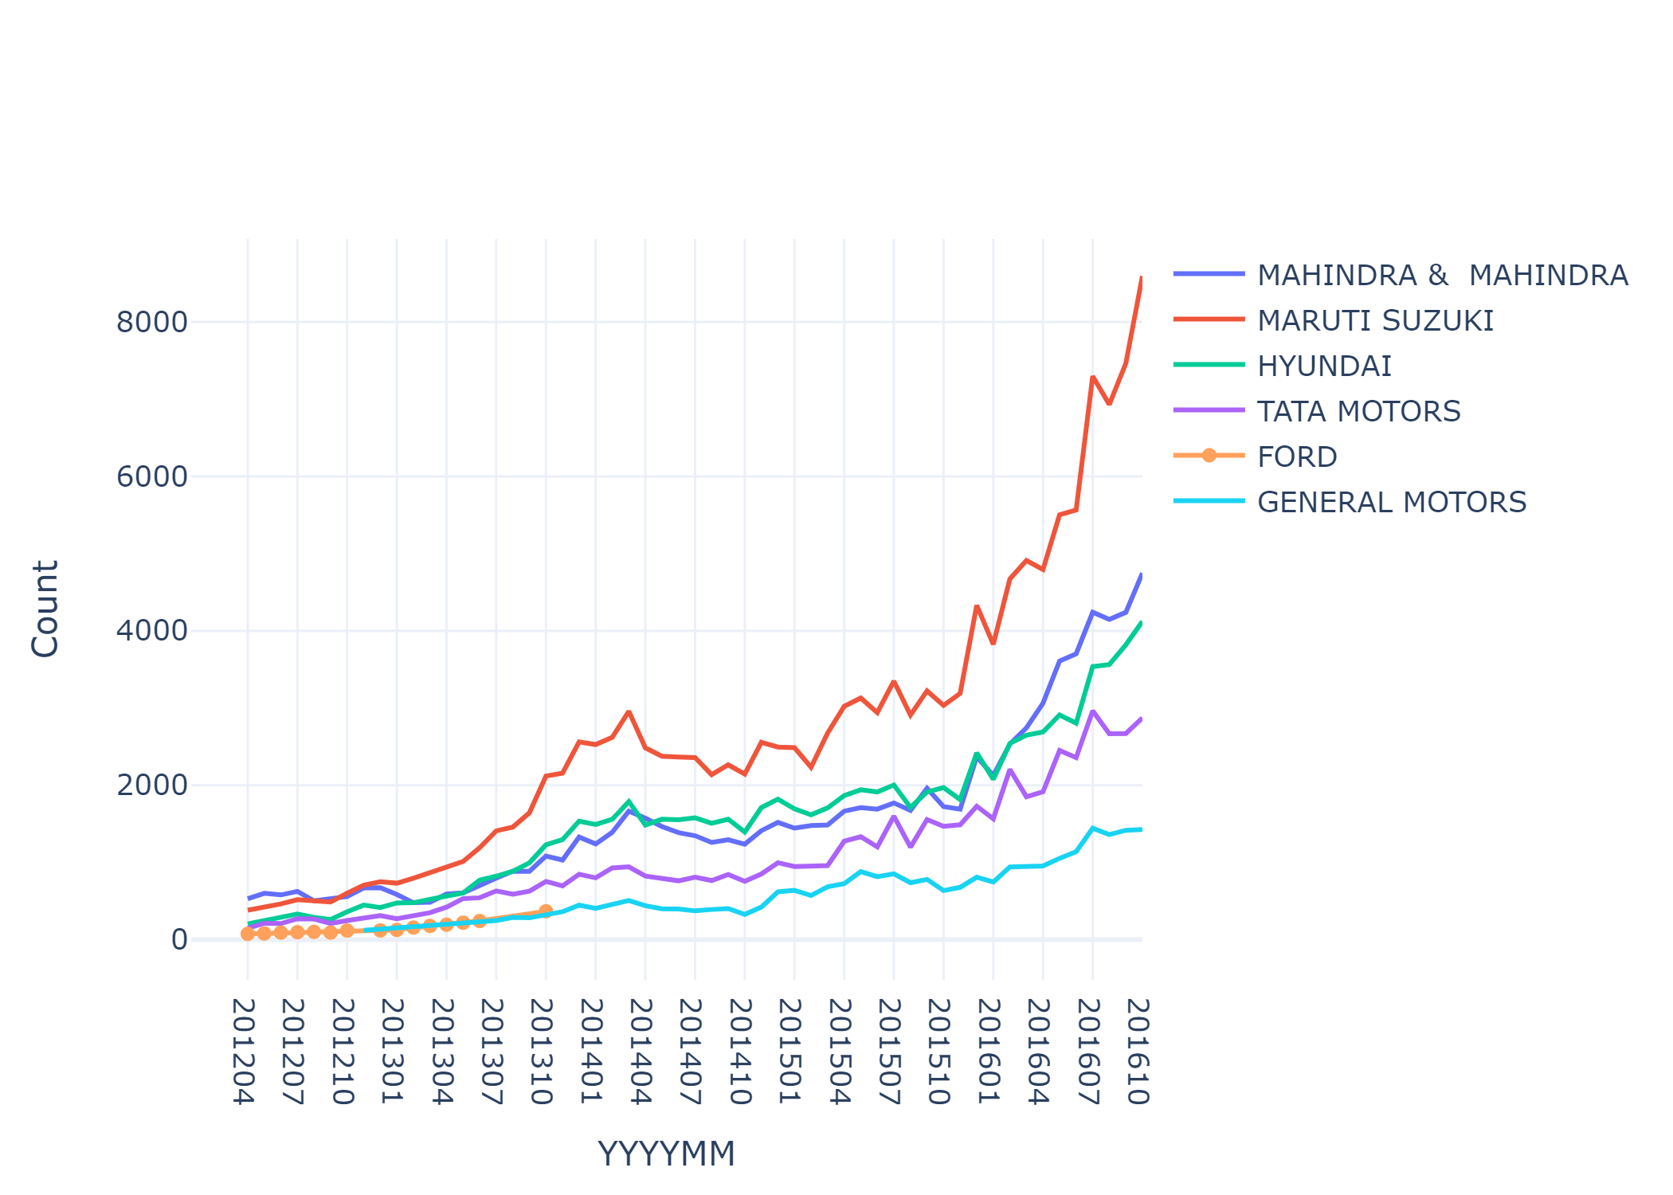
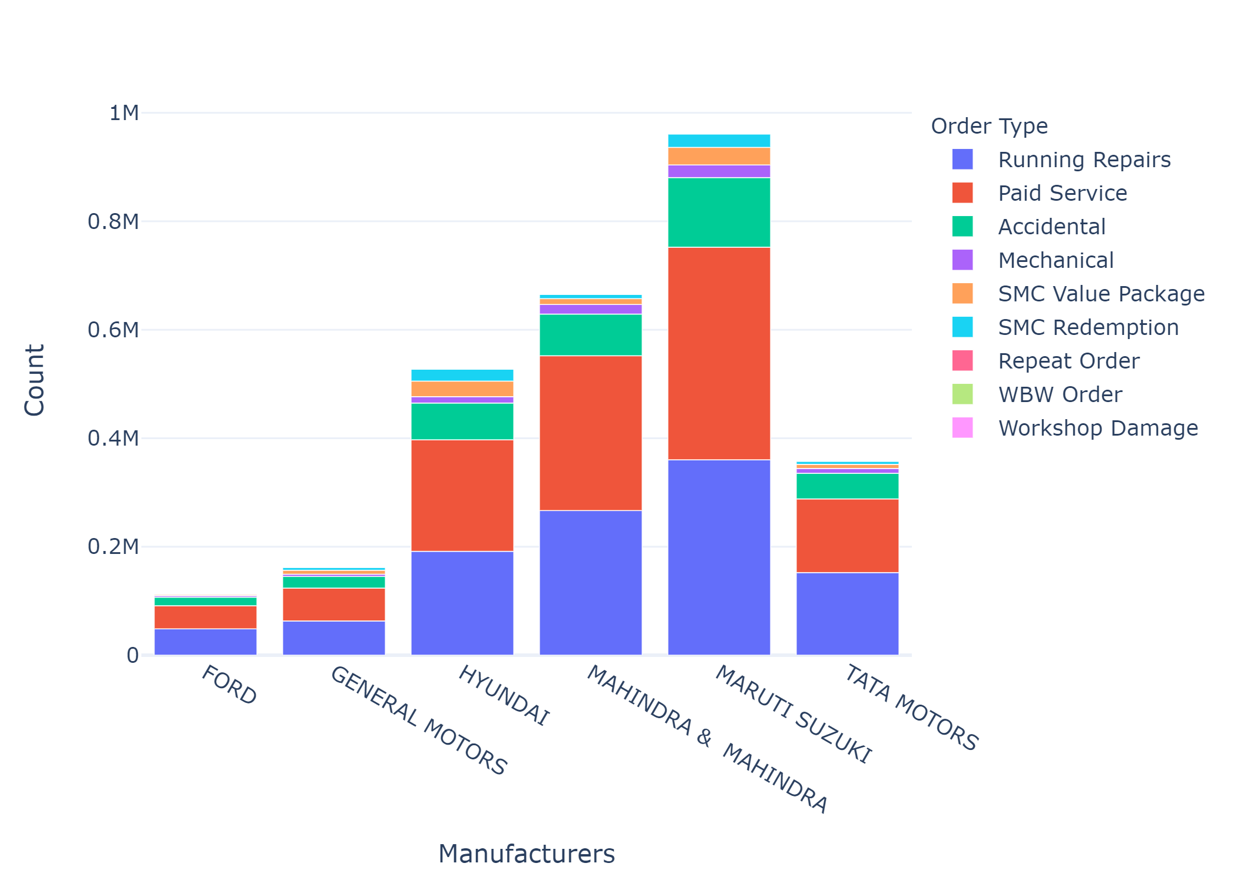
Top Manufacturers and there order type
Running Repairs & Paid Services are most common among top Manufacturers
Ford was 5th ranked car in Most popular car ranking during 2012 and 2013
Since General Motors has taken its place

Slide 5
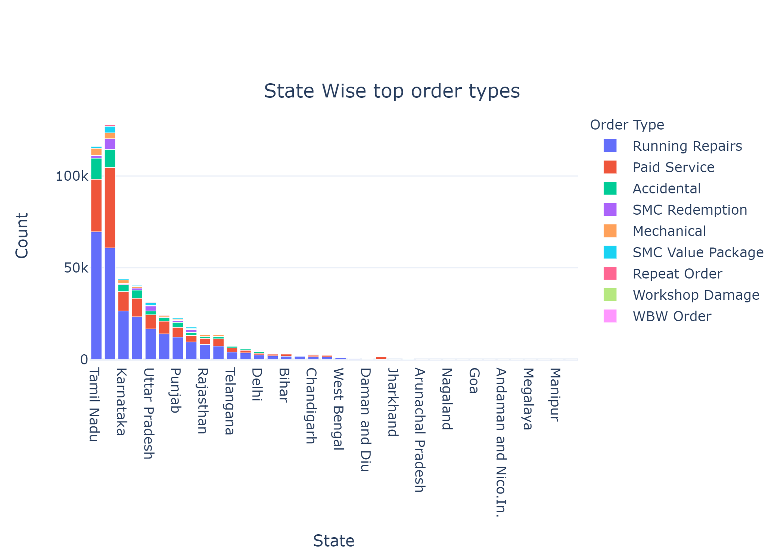
Problem Statement 2 : Identifying Order Type Pattern
Running Repairs & Paid Services are most common among top Manufacturers

Slide 6
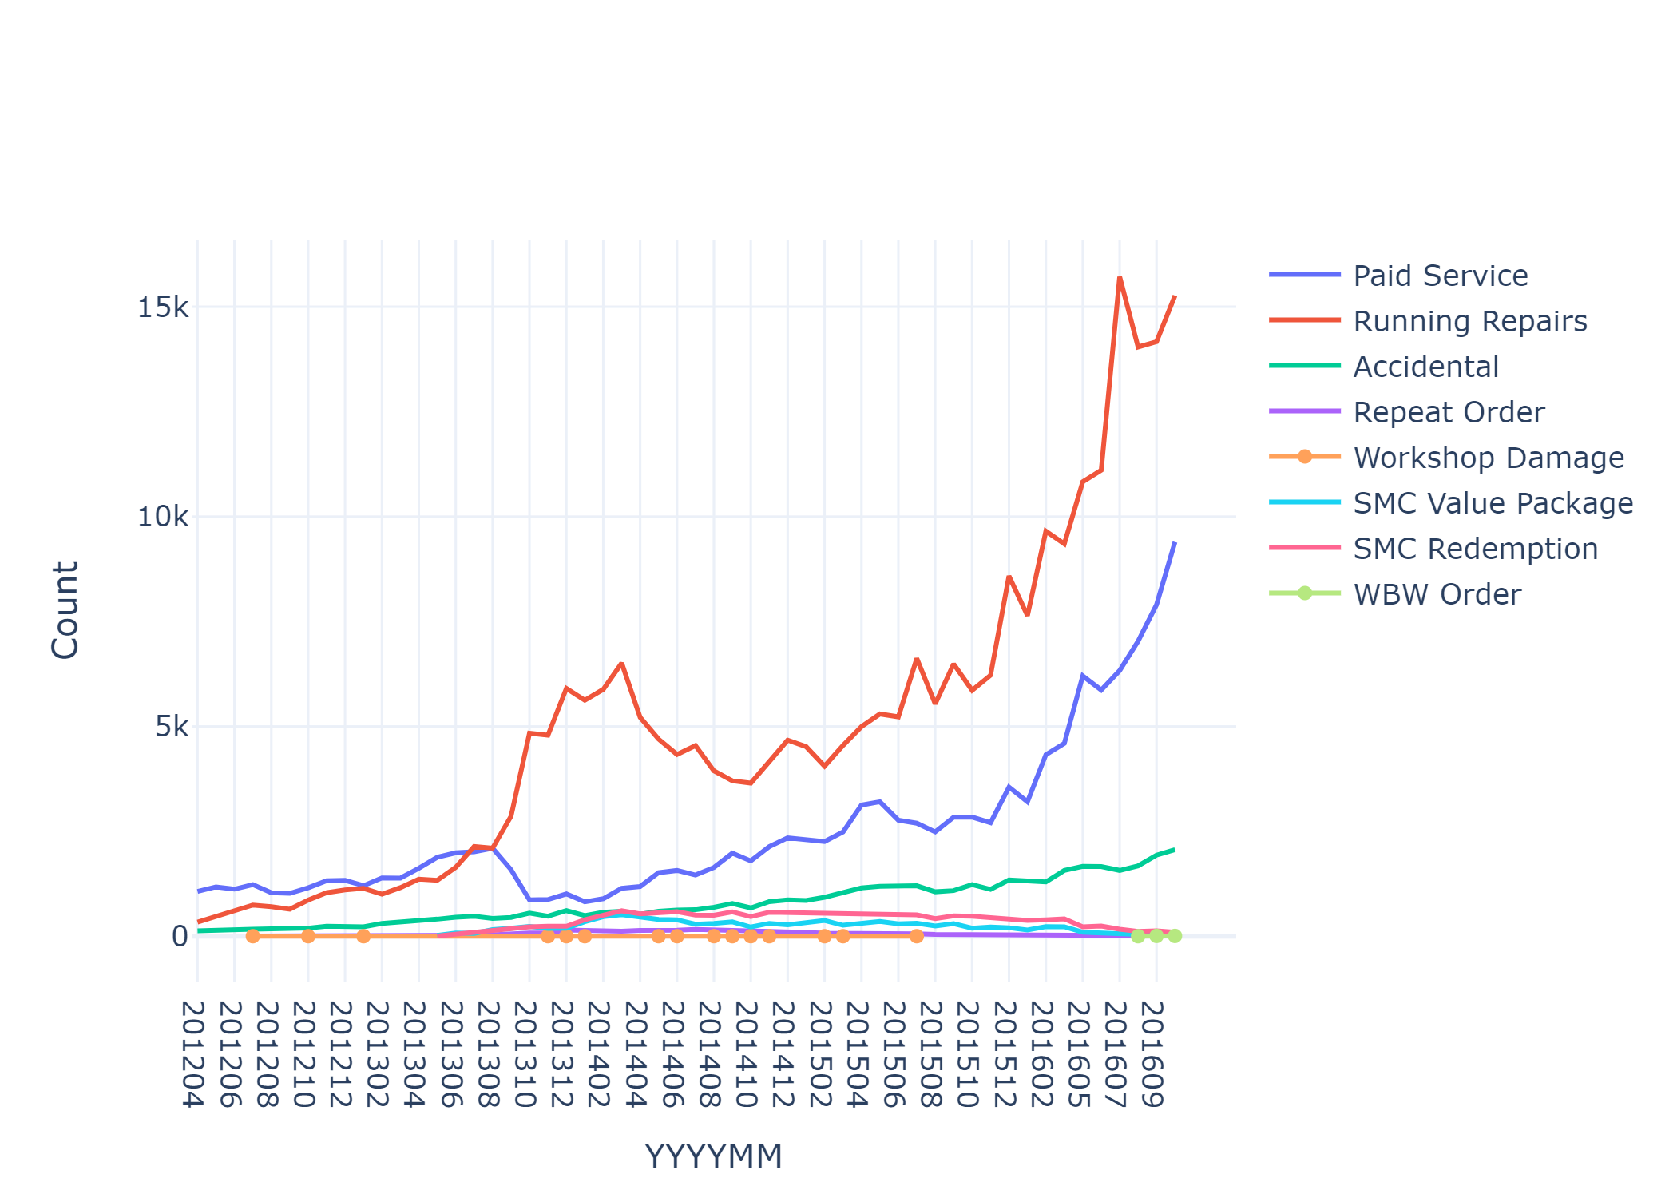
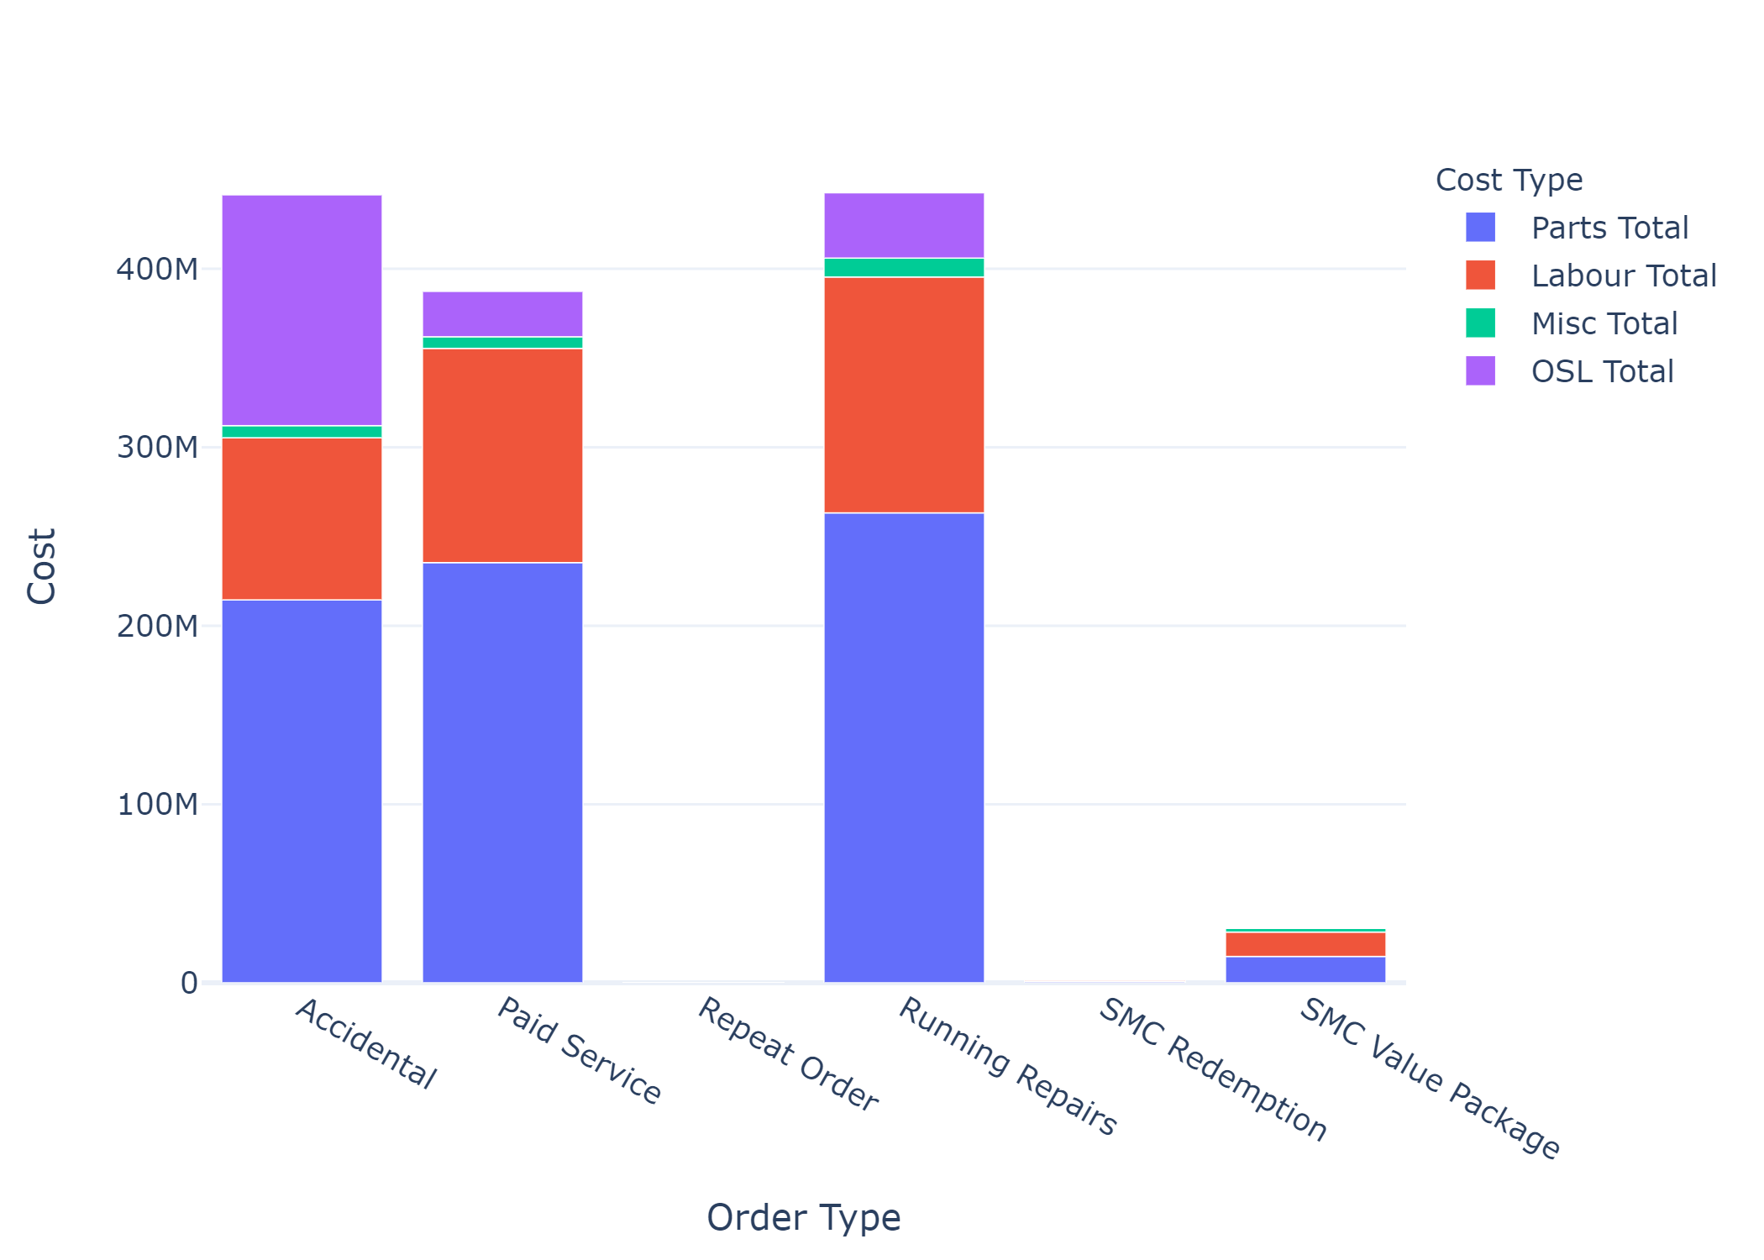
Cost for each order type
For all type of orders parts & Labor cost are maximum
For Accidental order type 25% of total amount goes towards outsourced work
For SMC and Repeated order type outsourced amount is 0
SMC package was introduced in May 2013

Slide 7
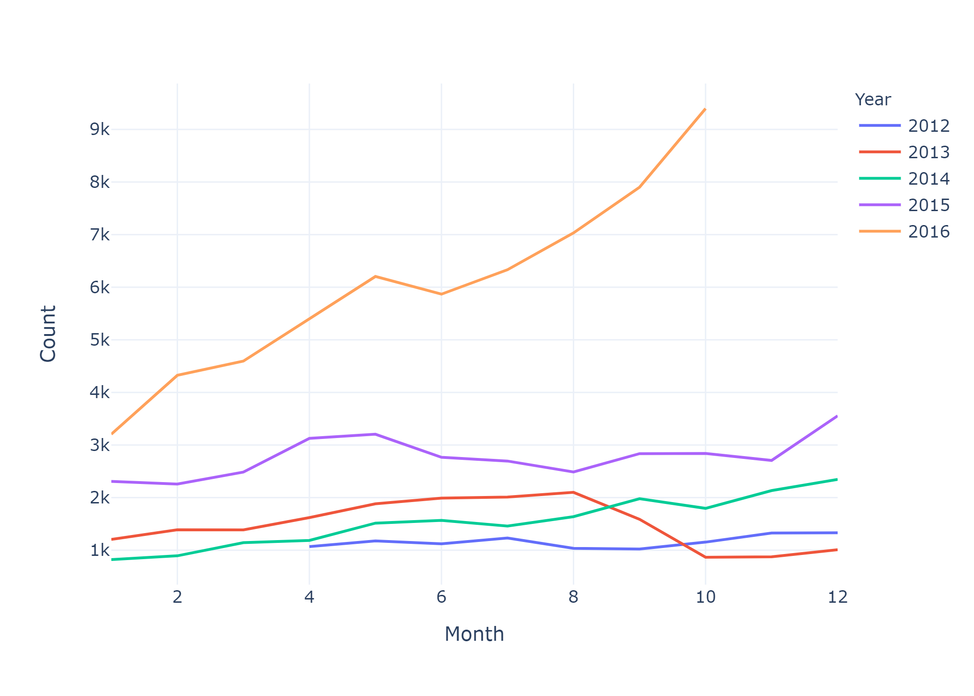
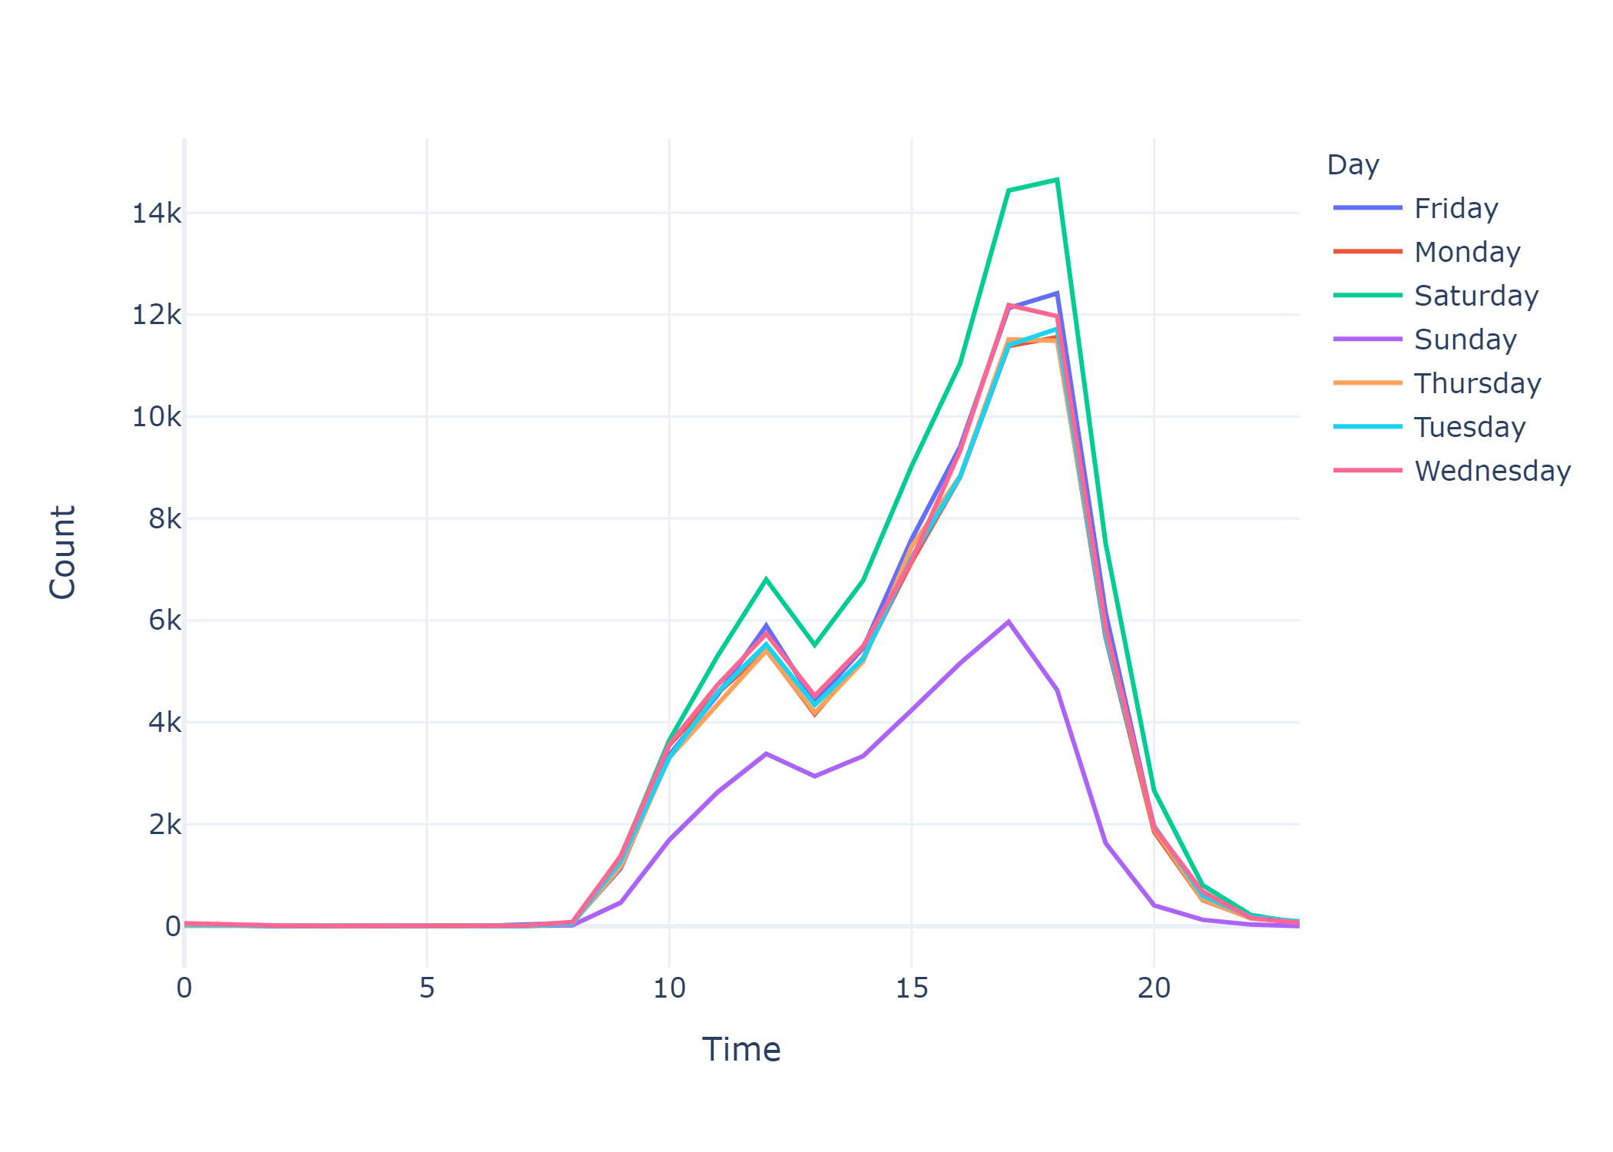
Is the service seasonal?
There is no pattern of customer increment in Monthly customer count
However there is 5PM-6PM is rush hour on daily basis
And on Sundays least numbers of customers comes

Slide 8
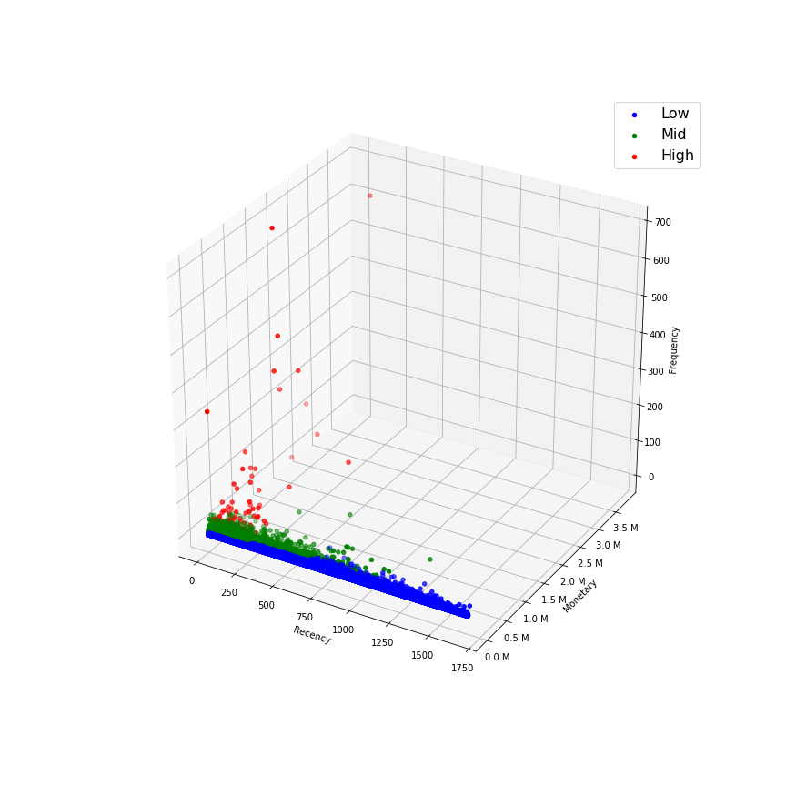
RFM Clustering
Customer are clustered based on there Recency, Frequency and Revenue
KMean clustering algorithm is used for clustering the users
We have clustered the customers in High, Mid and Low value clusters
High Level Approach
Using Elbow Method 4 clusters were selected for Recency, Frequency and Monetary
Overall Score = Recency Cluster + Frequency Cluster + Monetary Cluster
Customer clustering is done based on Overall Score

Slide 9
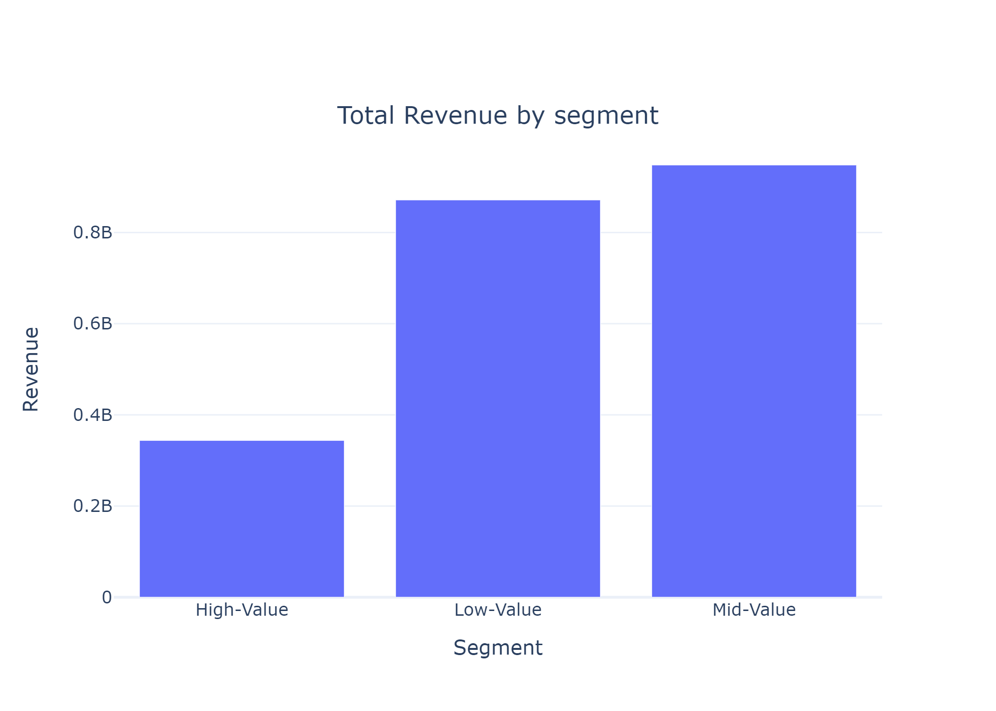
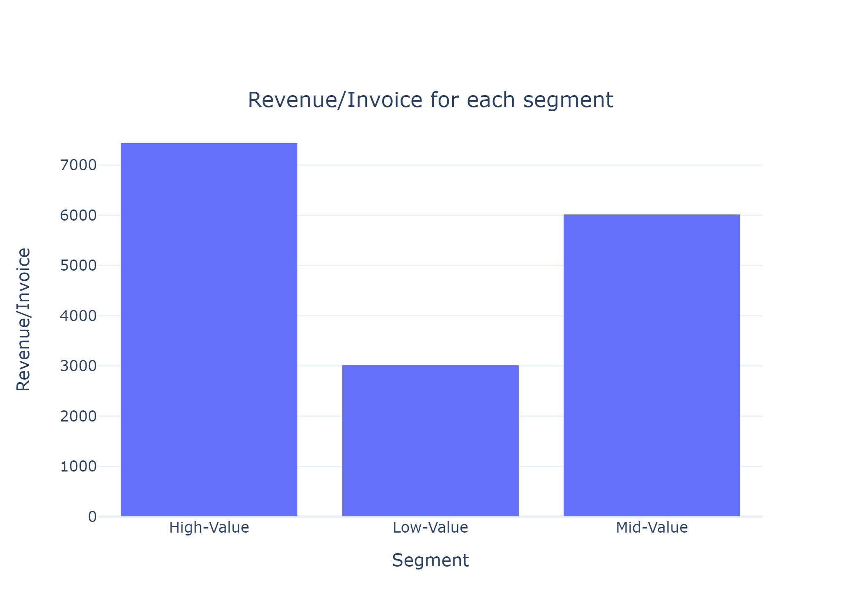
Revenue by each cluster
Although total revenue from High-Value Customer is Lowest
We can see that Revenue/invoice for each cluster is as per expected

Slide 10
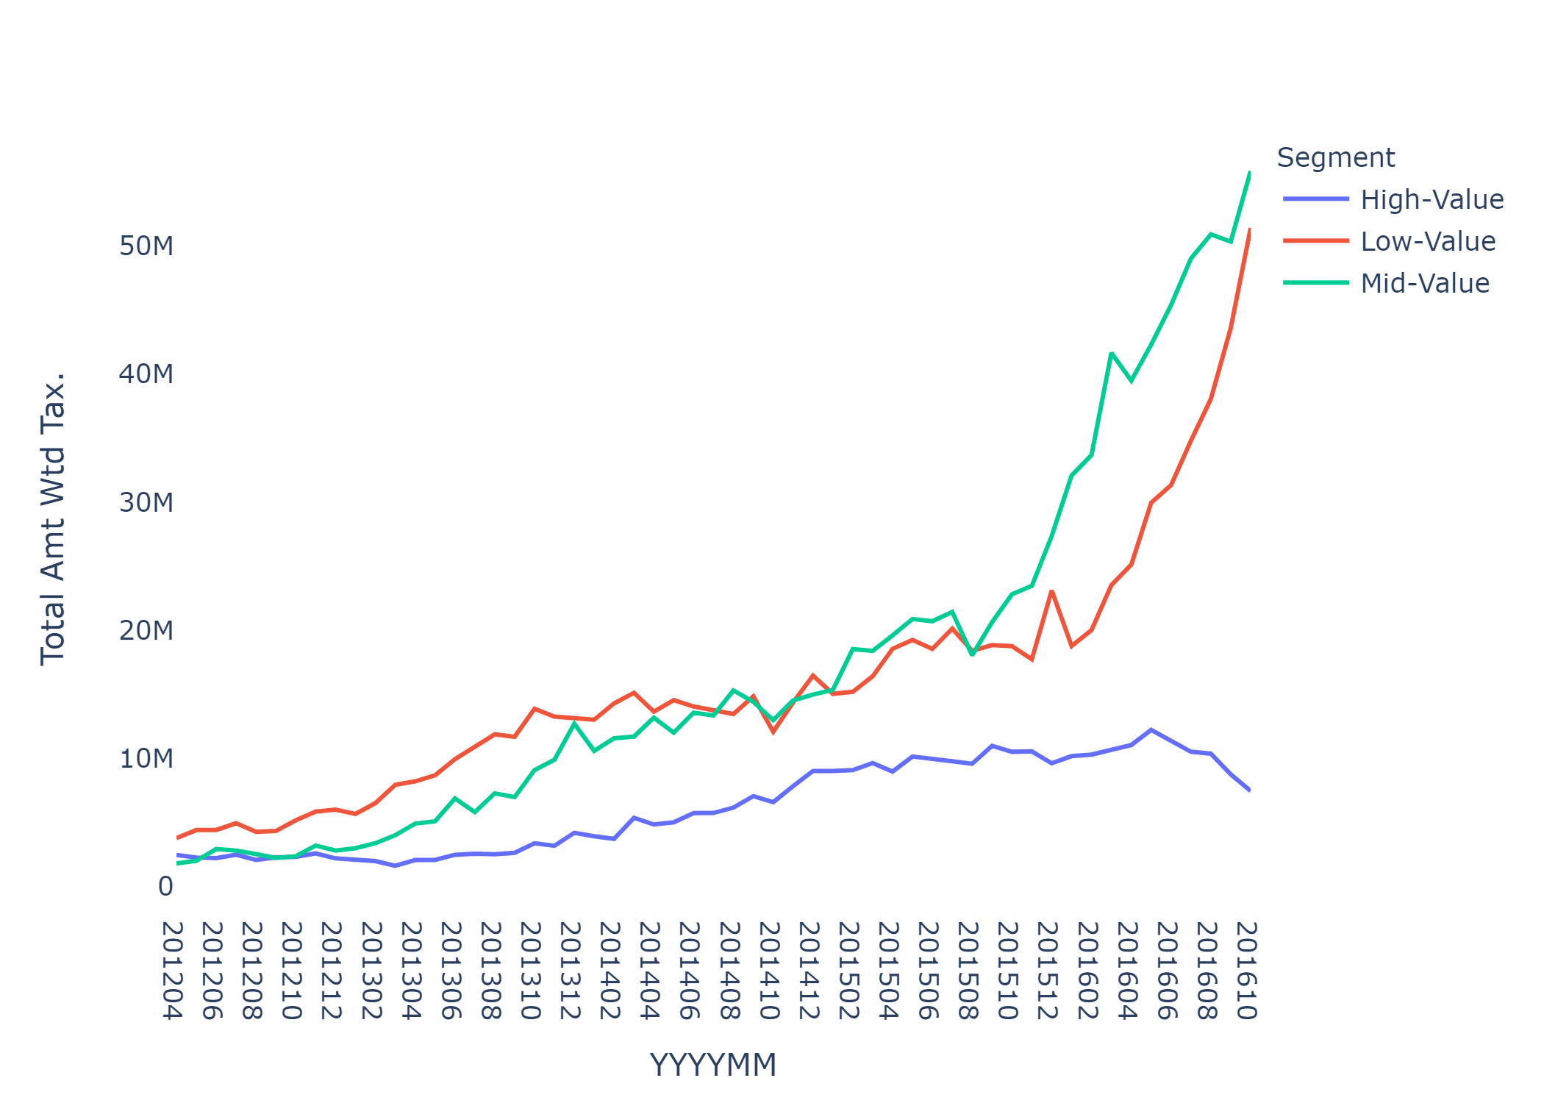
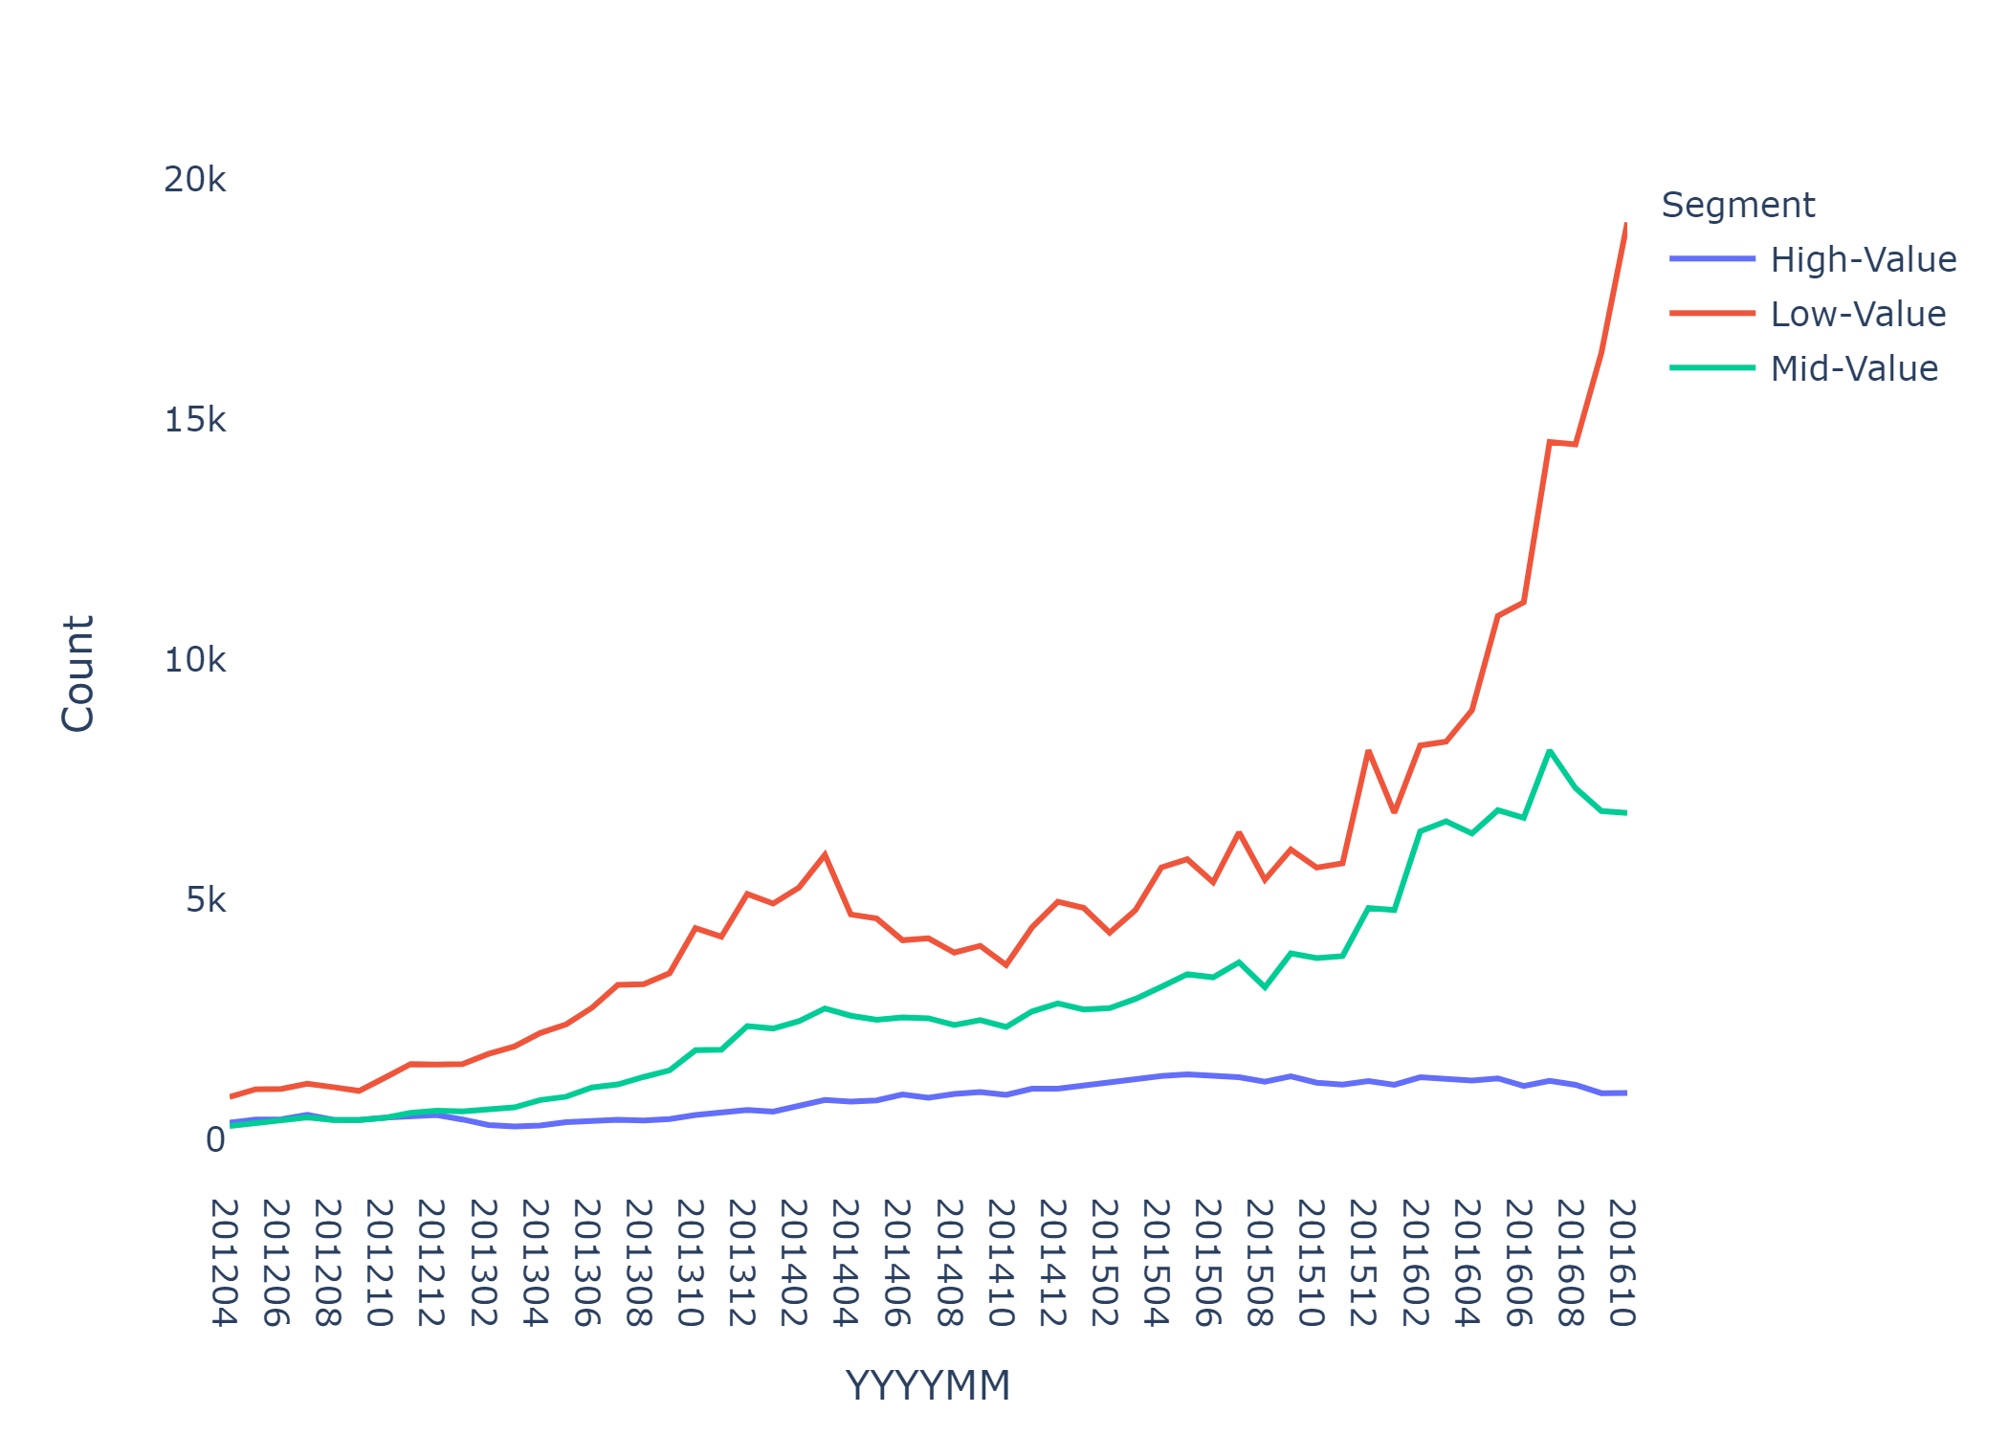
Historical Revenue & Count of Each Cluster
For High-Value customers recent count is almost same but there has been drop off in revenue
For Mid-Value customers there is some increment in customer count but increment revenue is huge
For Low-Value customers there is spike in count that’s because all the new customer will be going to this cluster

Slide 11
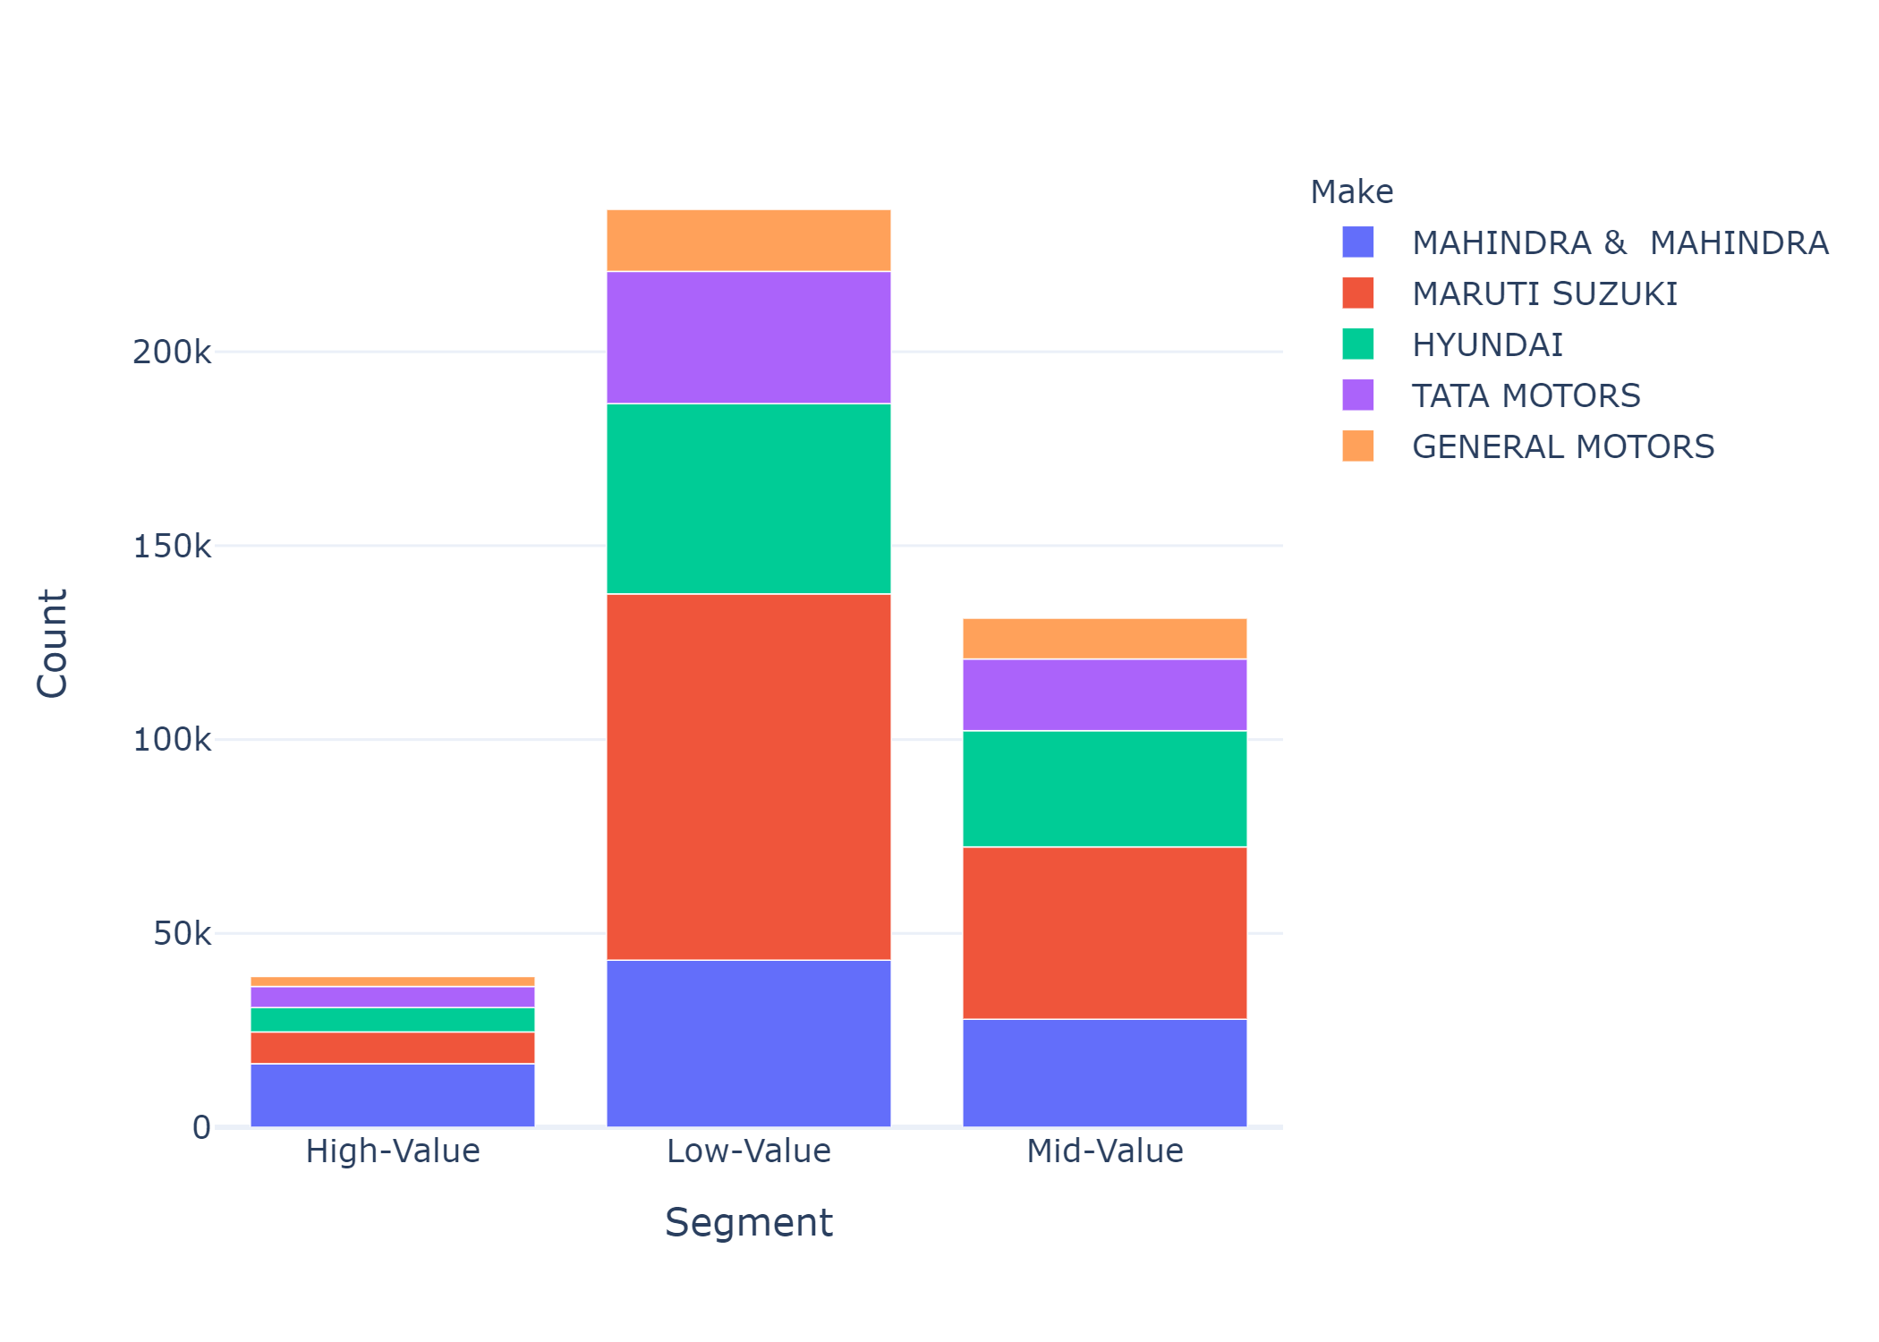
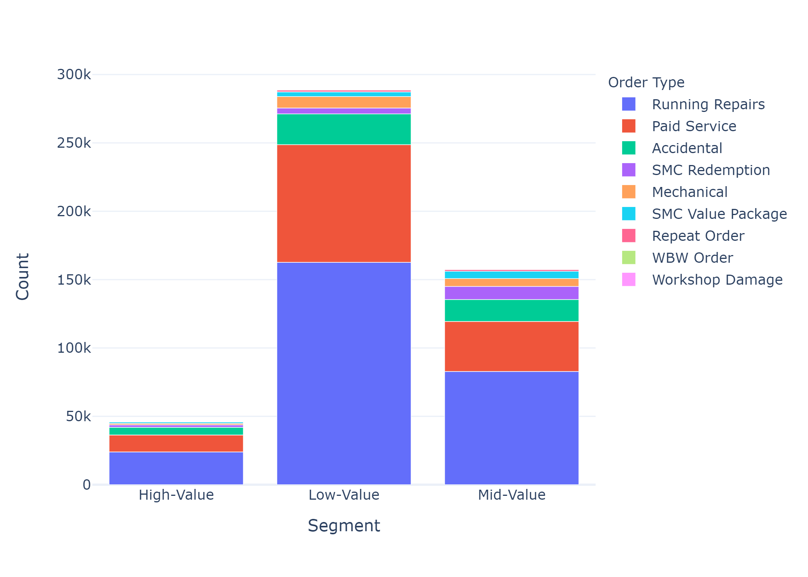
Top Manufacturers & Order Type of Each Cluster
Top Manufacturers are same for all clusters
Top Order Types are same for all cluster

Slide 12
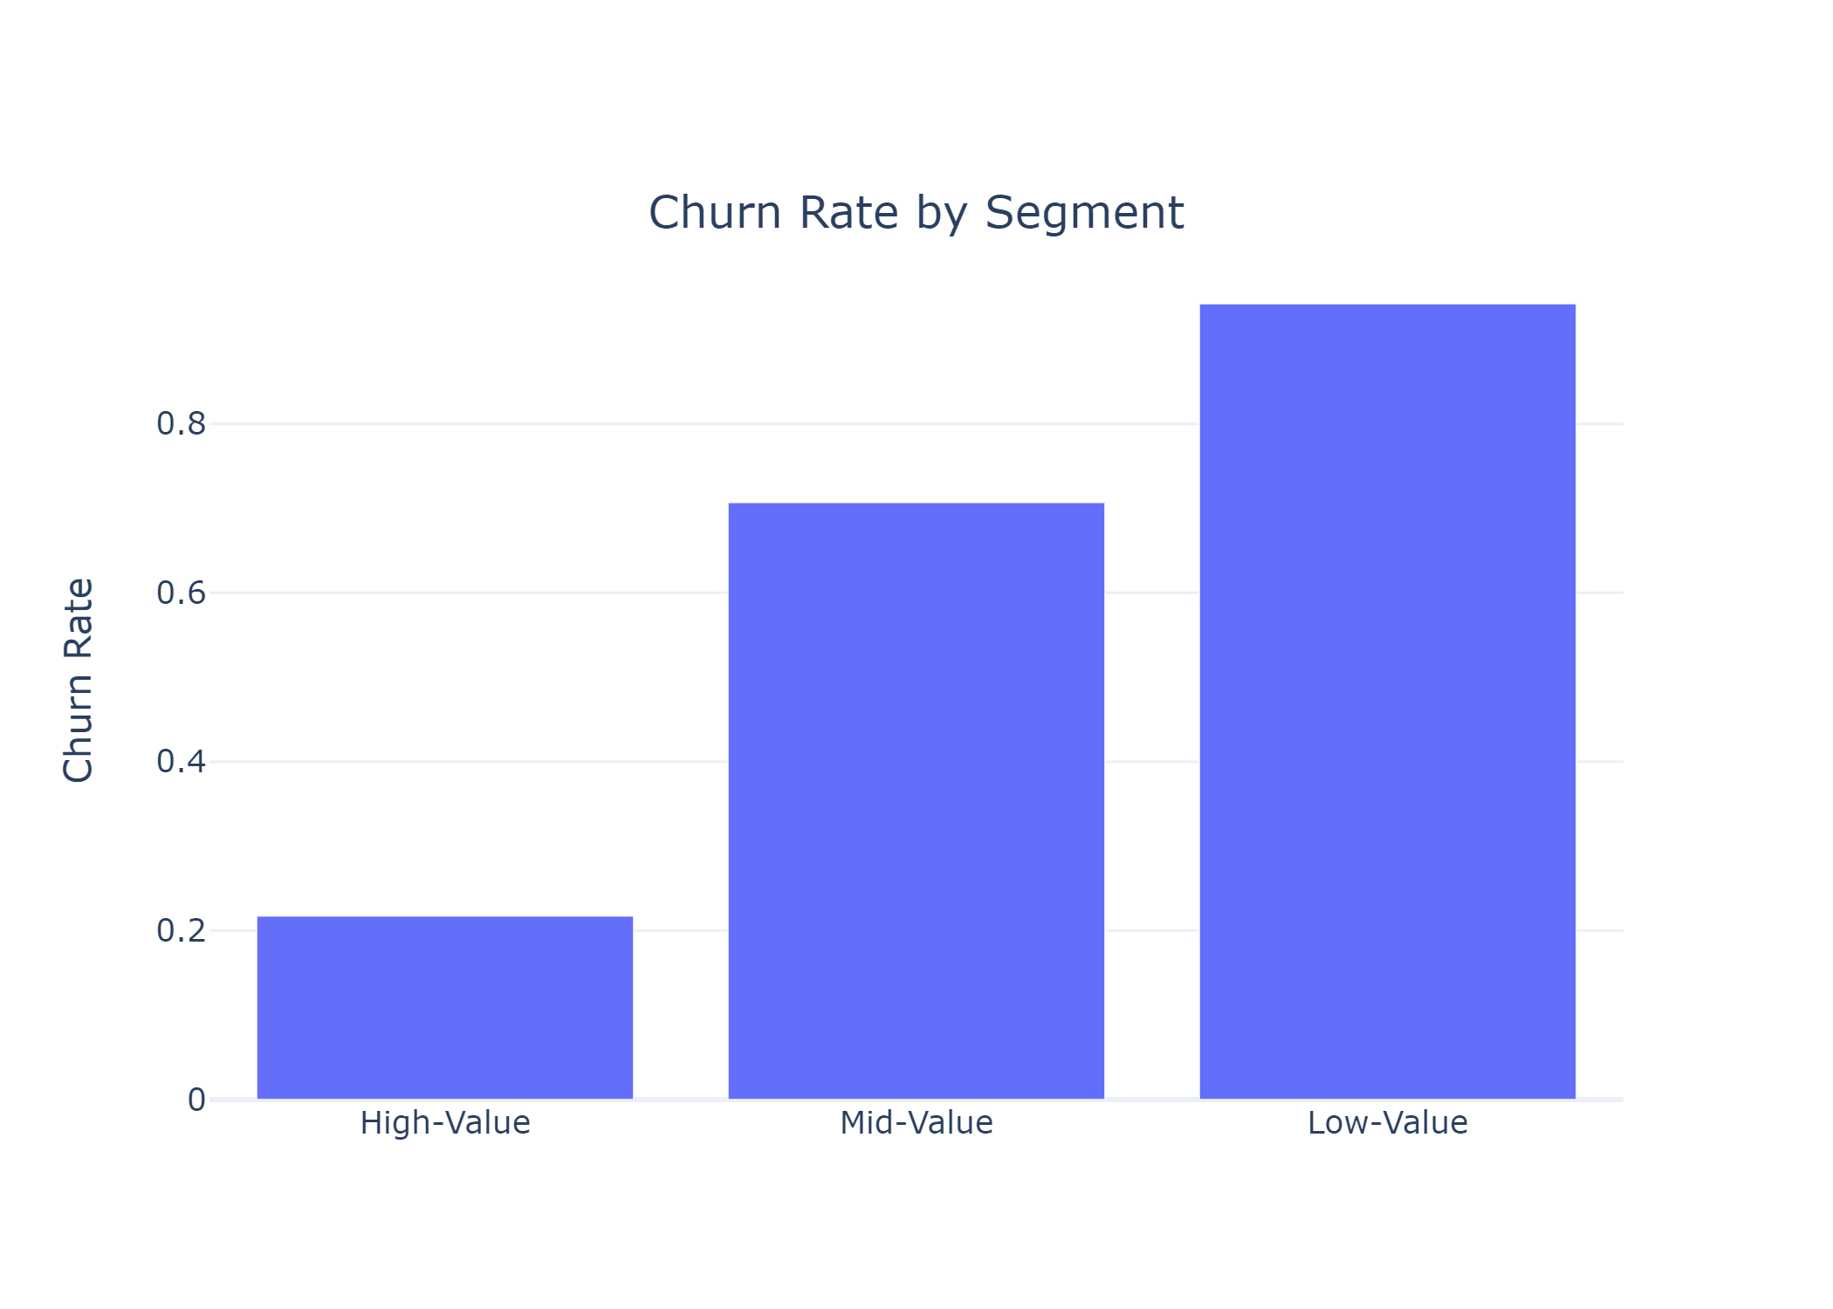
Churn-rate by segment
Churn Rate for High-Value customers are lowest at 21%, which is great compared to Low-Value customers at 94%
This is calculated by taking last 2 years as future data
730 days(2 years) should by enough this for any customer to revisit since mean for customer revising gap is 96 days

Slide 13
Customer LTV
0 for Low-LTV
1 for High-LTV
Logistic Regression(0.69)
Naïve Bayes(0.58)
Random Forest(0.63)
SVC(0.66)
Decision Tree(0.56)
KNN(0.60)
XGBoost(0.72)
 | precision | recall | f1-score | support
0 | 0.68 | 0.79 | 0.73 | 3836
1 | 0.75 | 0.63 | 0.69 | 3799
accuracy |  |  | 0.71 | 7635
macro avg | 0.72 | 0.71 | 0.71 | 7635
weighted avg | 0.72 | 0.71 | 0.71 | 7635

Slide 14
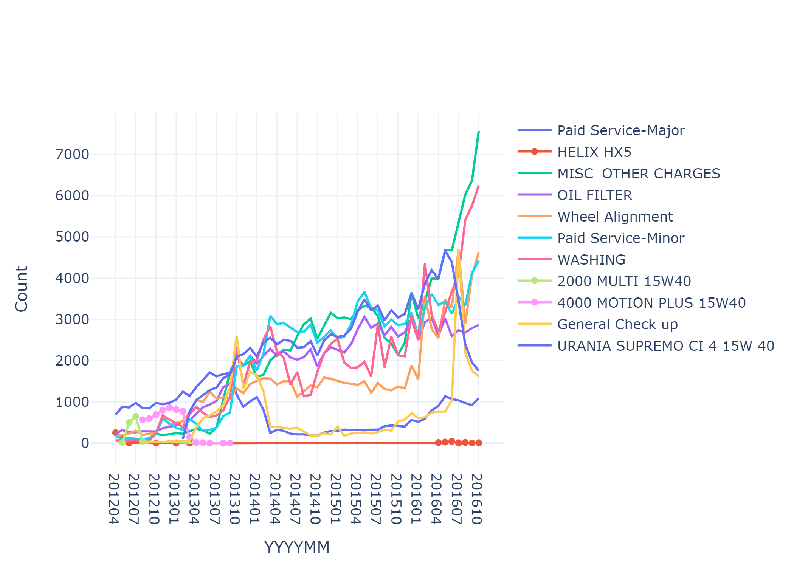
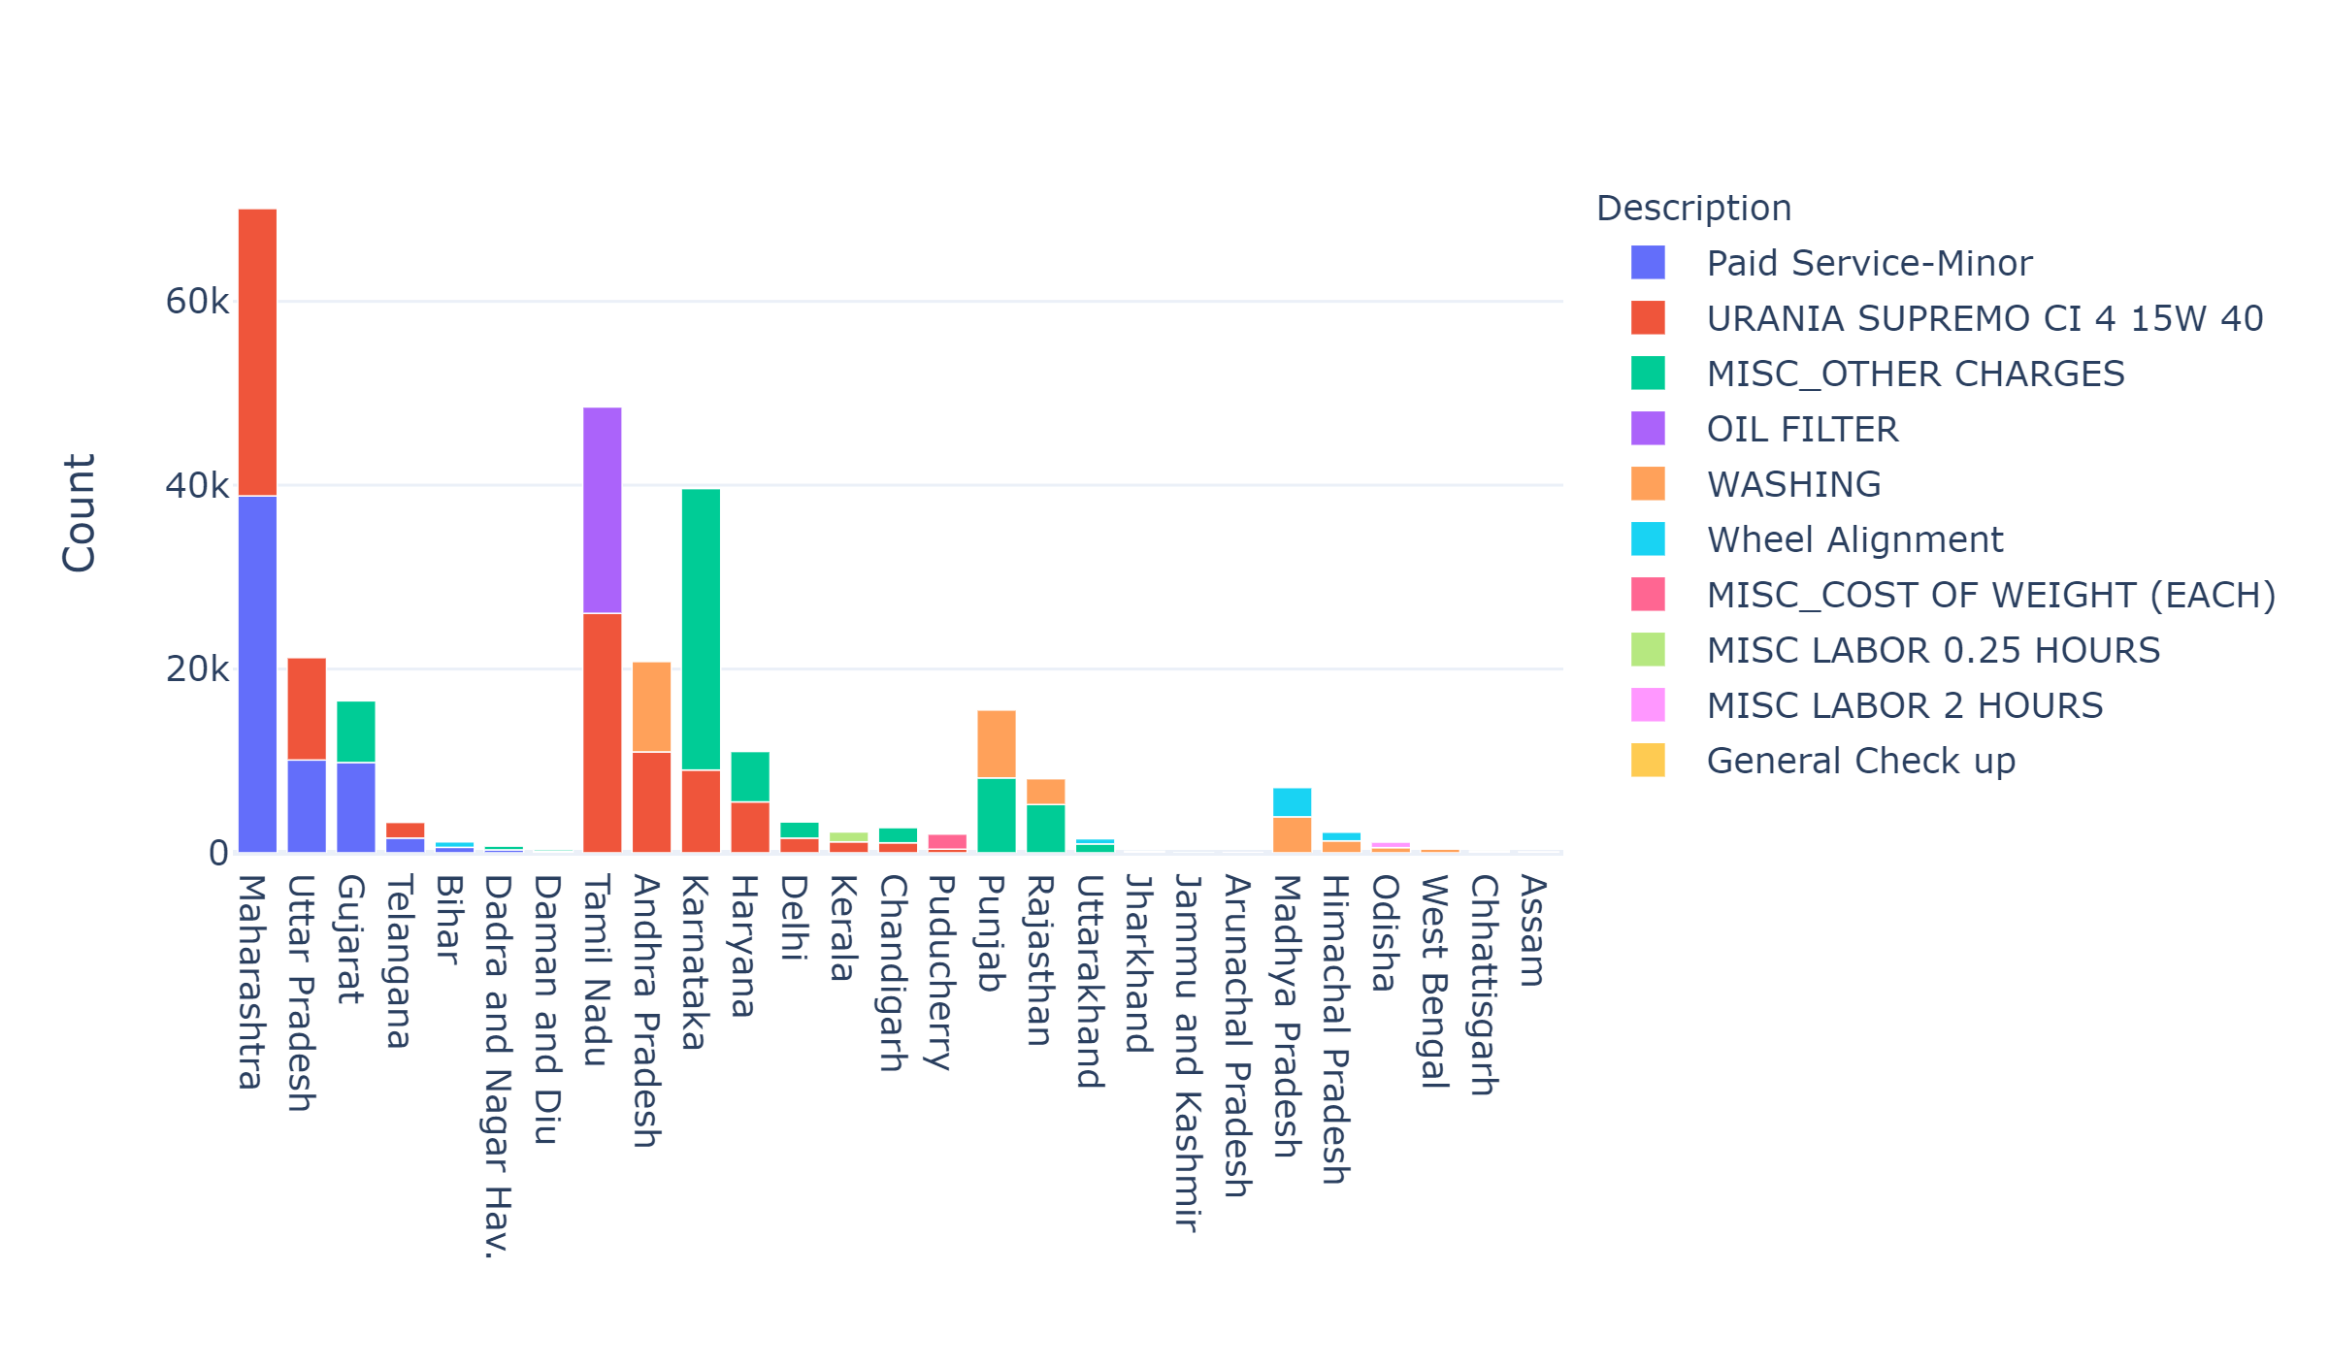
Inventory analysis : Top Inventory item
Mirror Service, Engine Oil and Oil Filter most used item for most of the states
Historically Oil Filter and Engine Oil are most used Inventory Items

Slide 15
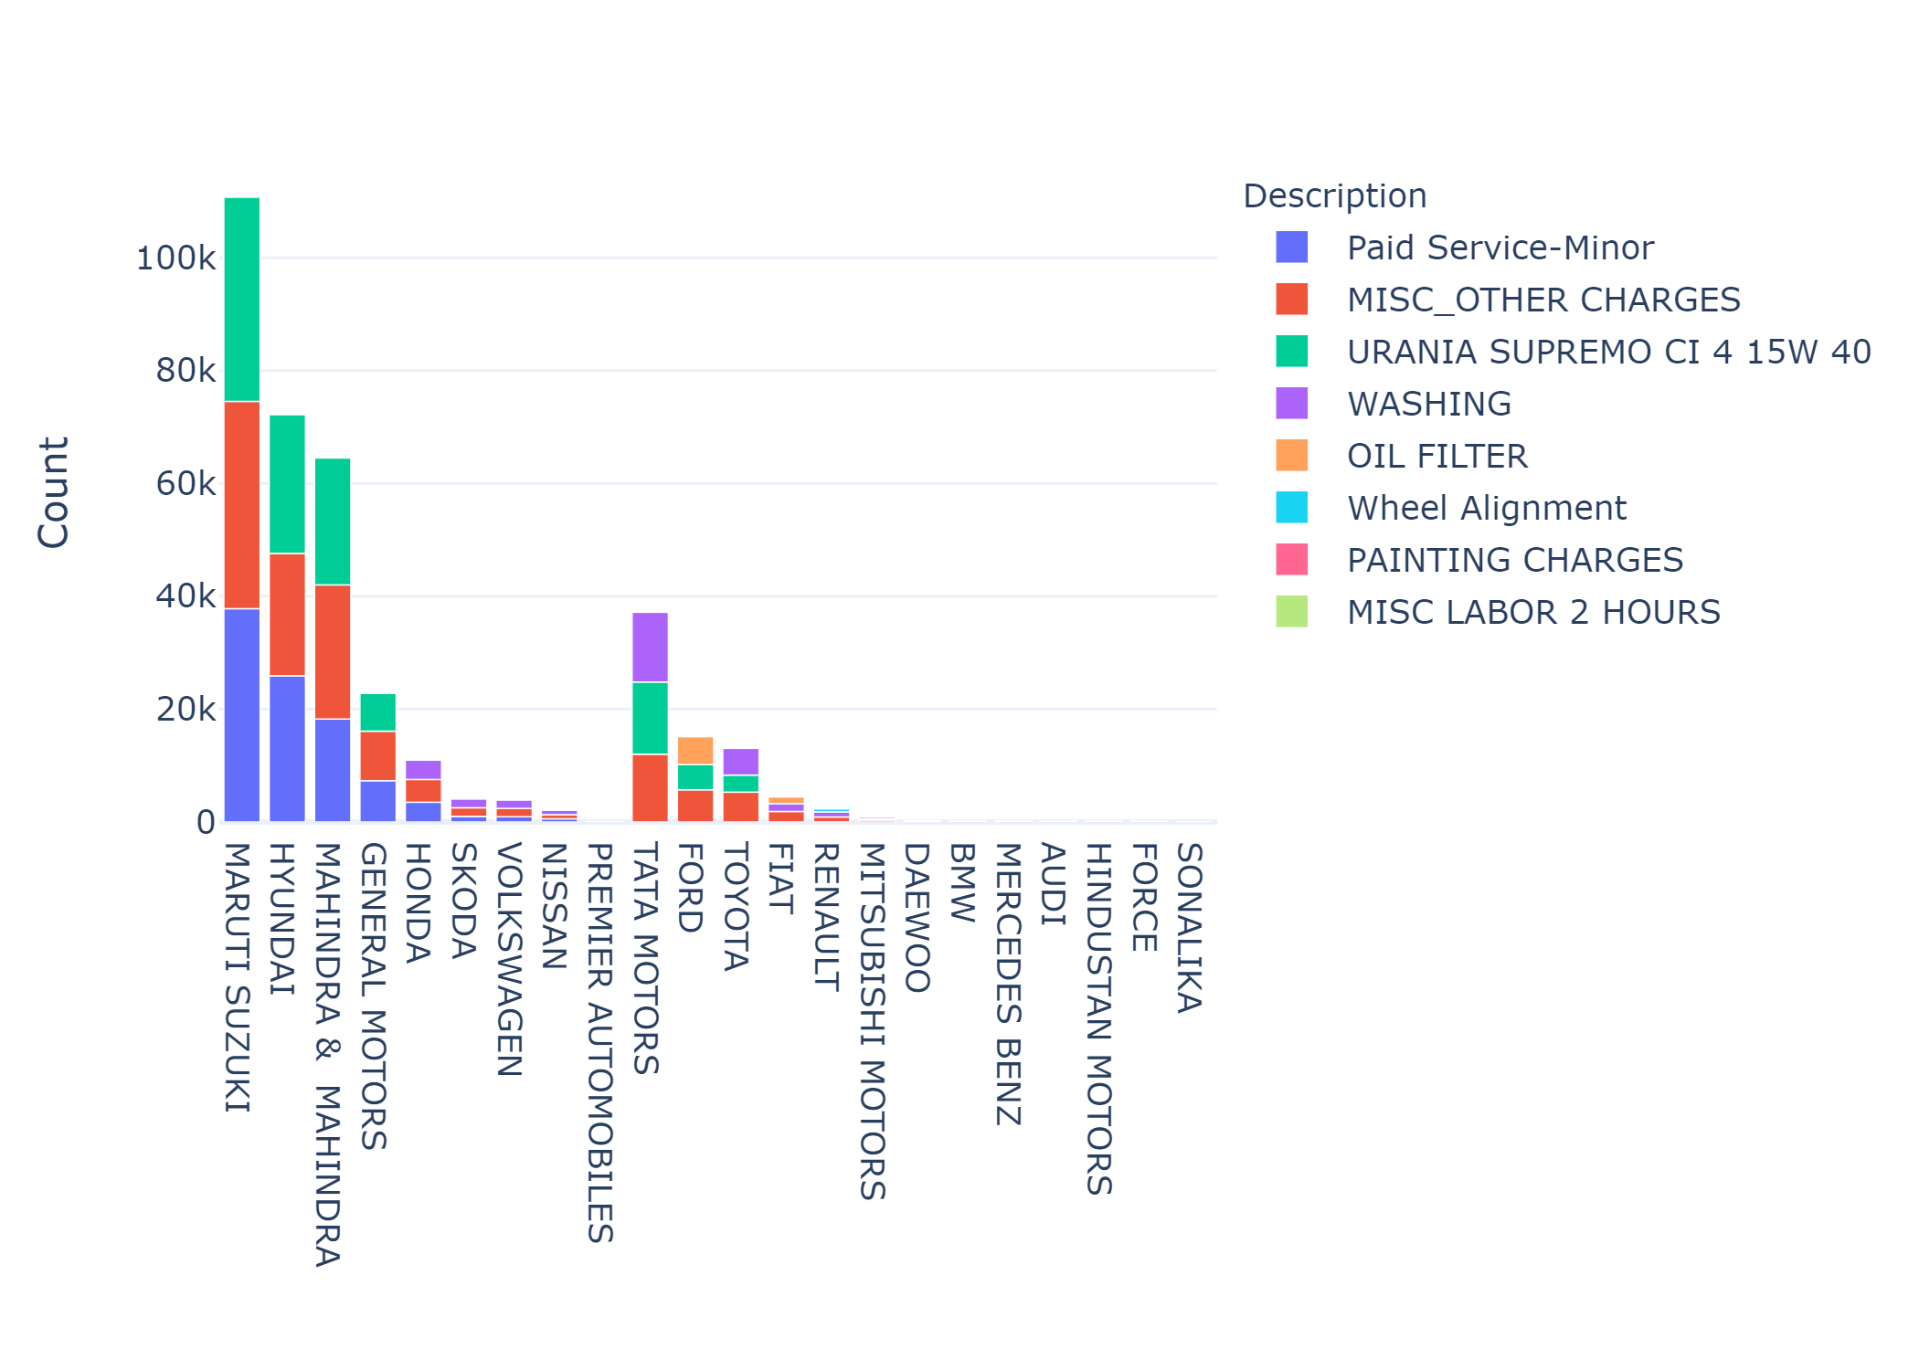
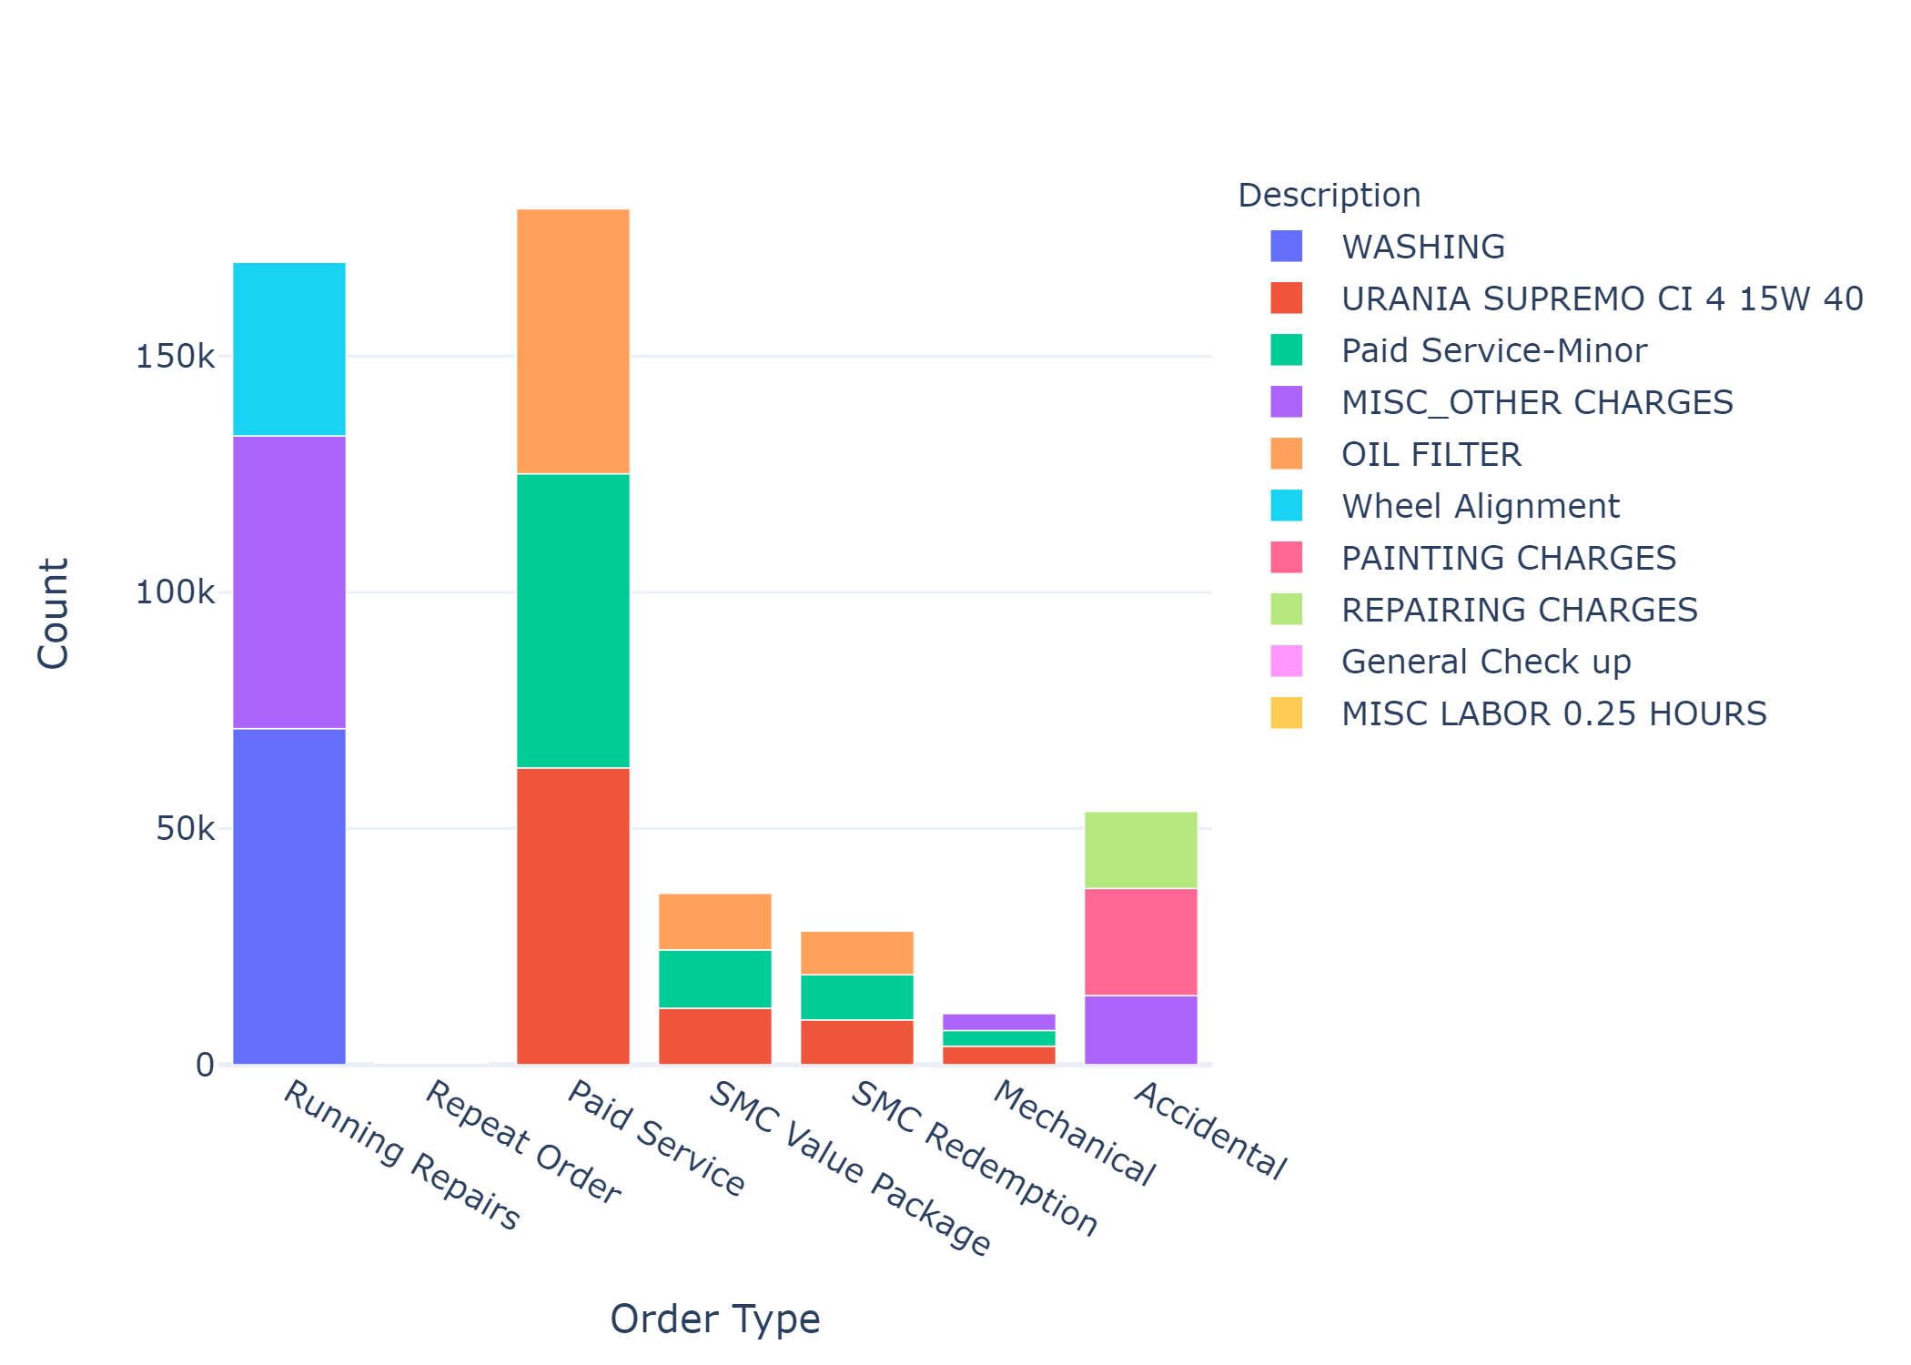
Top Inventory item by Manufacturers & Order Type
Mirror Service, Engine Oil and Oil Filter most used item for most of the states

Slide 16
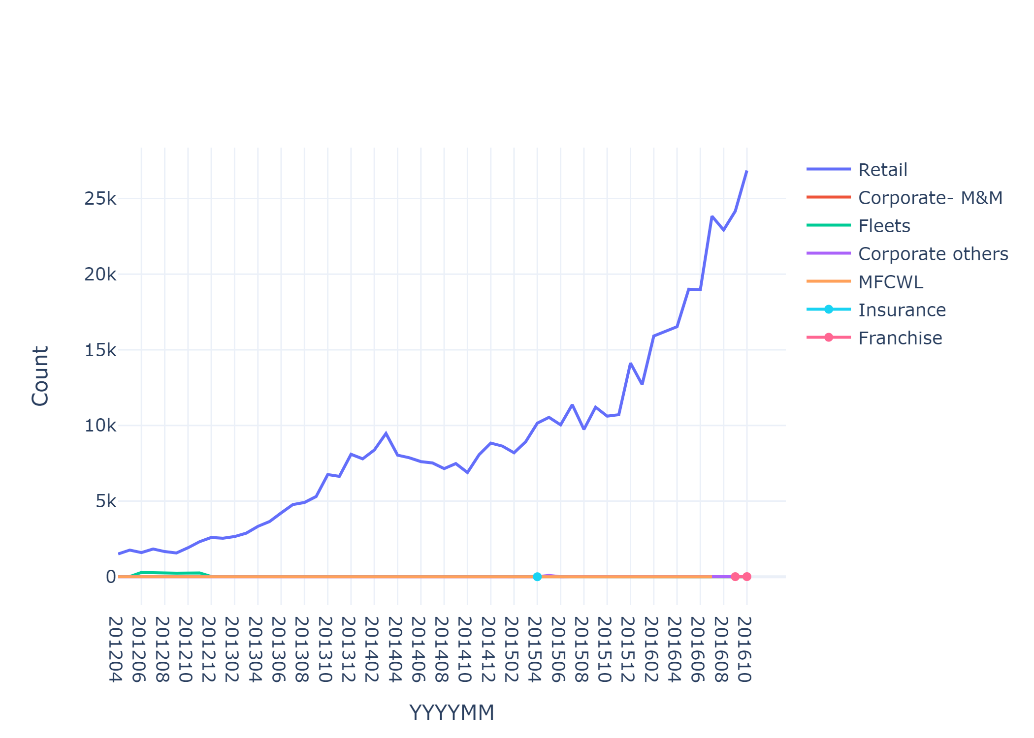
Marketing Recommendations
Retail customers are our biggest customer base
As of other marketing recommendations, invoice data consists of customer details with only Z001 as data origin

Slide 17
Value delivered to the business
For Accidental order type 25% of total amount goes towards outsourced work, repairing the some part can reduce outsourced work
There is no seasonally rush, but on daily basis 5PM-6PM are rush hours
Mid-Value customers are most revenue generating cluster
Recently we have been losing lots of High-Value customers
Churn rate is 70% for Mid-Value customer we should focus on reducing it
We Should Stock Engine Oil, Oil Filter since they are high demand items

Slide 18
Next steps
Gather more data for other types of data origin
Using collected do marketing recommendation

Slide 19
Thank You

